Slide 1
Bible Prophecy
Christians are to have nothing to do with Psycics, Horoscopes, Palm-reading, or Fortune telling – It is WITCHCRAFT
Understanding the Basics
Isaiah 46:9-10 Remember the former things of old: for I am God, and there is none else; I am God, and there is none like me,
10 Declaring the end from the beginning, and from ancient times the things that are not yet done, saying, My counsel shall stand, and I will do all my pleasure:

Slide 2
My Goals In Teaching Prophecy
I would like passages in the Bible to make sense when you read them.
Psalm 65:12-13 They drop upon the pastures of the wilderness: and the little hills rejoice on every side.
The pastures are clothed with flocks; the valleys also are covered over with corn; they shout for joy, they also sing.
Psalm 96:10-13 Say among the heathen that the LORD reigneth: the world also shall be established that it shall not be moved: he shall judge the people righteously.
11 Let the heavens rejoice, and let the earth be glad; let the sea roar, and the fulness thereof.
12 Let the field be joyful, and all that is therein: then shall all the trees of the wood rejoice
Before the LORD: for he cometh, for he cometh to judge the earth: he shall judge the world with righteousness, and the people with his truth.
Isaiah 55:12 For ye shall go out with joy, and be led forth with peace: the mountains and the hills shall break forth before you into singing, and all the trees of the field shall clap their hands.
The answer to how these things that can be is found in Romans 8

Slide 3
Romans 8:18-23 For I reckon that the sufferings of this present time are not worthy to be compared with the glory which shall be revealed in us. 19 For the earnest expectation of the creature waiteth for the manifestation of the sons of God. 20 For the creature was made subject to vanity, not willingly, but by reason of him who hath subjected the same in hope,
Because the creature itself also shall be delivered from the bondage of corruption into the glorious liberty of the children of God. 22 For we know that the whole creation groaneth and travaileth in pain together until now. 23 And not only they, but ourselves also, which have the firstfruits of the Spirit, even we ourselves groan within ourselves, waiting for the adoption, to wit, the redemption of our body.
I Pray you would see the time is short
I Do Believe We Can Have Revival; I Believe We Are Going To See Revival; I Believe We Are Not Having Revival Now.
Revelation 12:11 And they overcame him by the blood of the Lamb, and by the word of their testimony; and they loved not their lives unto the death.
I Pray You Would See You Don’t Have Long Here – This World is Not Supposed to Be Your Home
You are to Read, Memorize and Study Your Bible –
2 Timothy 2:15 Study to shew thyself approved unto God, a workman that needeth not to be ashamed, rightly dividing the word of truth.

Slide 4
What ever you learn about prophecy is supposed to:
Strengthen your faith in God’s Word – II Peter 1:19-21
Help you long for the appearance of Jesus Christ, the rapture - II Tim. 4:8
Move you to do more for Jesus before He comes back – Matt. 24:43-46
Help you live holy – II Peter 3:11
Help you to properly place Biblical events on the timeline – Luke 24:27
You can have a scriptural wisdom and understanding of the times
Help you to stay doctrinally sound in rightly dividing the Word of God – Matt. 22:28-30 “… Ye do err, not knowing the scriptures, nor the power of God.” (Mark 12:27) - Luke 19:44 And shall lay thee even with the ground, and thy children within thee; and they shall not leave in thee one stone upon another; because thou knewest not the time of thy visitation.
Beware of PRIDE Learning prophecy can be mentally intoxicating
1 Corinthians 8:1 Now as touching things offered unto idols, we know that we all have knowledge. Knowledge puffeth up, but charity edifieth.

Slide 5
Why Christians Don’t Study Prophecy:
(1) Some mistakenly think that the subject is too involved and difficult.
Some feel that to study prophecy leads to speculation. There is a danger of this, but surely we can be Spirit-led in our study of God's truth?
(3) Still others say that the prophetic outlook is a very dark one and that to study it leads to pessimism.
THERE ARE TWO EXTREMES
LIVING AT PROPHECY SEMINARS
DISCREDITING PROPHECY
You can tell when Prophecy is taken too far –
When you are looking for “signs of His coming” more than looking for “Him who is coming” you’ve turned prophecy into something God never intended it to be.

Slide 6
The Rapture is the APPEARING – I Tim. 6:16; II Tim. 1:10; 4:1, 8, Titus 2:13, I Peter 1:7
The Rapture is in the Old Testament as well as the New Testament
It’s the next thing to happen, I am not looking for a sign, I’m listening for a sound!
Your hope for it purifies you – I John 3:1-3
Since it can happen at any moment, live so you won’t be ashamed – I John 2:28

Slide 7
Revelation 4 = The Rapture
The Rapture happens because the church looses it’s salt – Romans 11:17-23
The Judment Seat of Christ happens after the Rapture
Crowns
I Thess. 2:19 – Soul Winner’s Crown
I Peter 5:4 – Shepherd’s Crown
Rev. 2:10 – Martyr’s Crown
II Tim. 4:8 – Crown of Righteousness
James 1:12 – Crown of Life (enduring temptation)
Revelation 4:10-11 Crowns to Cast
Your sins are not put on a giant screen
You loose rewards if you don’t live right –
II John vs. 8

Slide 8
Revelation 19:10 And I fell at his feet to worship him. And he said unto me, See thou do it not: I am thy fellowservant, and of thy brethren that have the testimony of Jesus: worship God: for the testimony of Jesus is the spirit of prophecy.
The Creator and King of the Universe died for me 2,000 years ago and is coming to reign.
What is the theme of the whole BIBLE?
NOT Salvation
but A Throne

Slide 9
Prophecy – a divinely inspired utterance in the foretelling of future events
There is the Old Testament position of Prophet or a fore teller of the Word of God
Numbers 11:29 And Moses said unto him, Enviest thou for my sake? would God that all the LORD'S people were prophets, and that the LORD would put his spirit upon them!
1 Corinthians 14:31 For ye may all prophesy one by one, that all may learn, and all may be comforted.
1 Corinthians 14:39 Wherefore, brethren, covet to prophesy,…
Just like Agabus prophesied to Paul about what was going to happen when he went to Jerusalem in Acts 21:9-12,
You can walk with the Lord so closely that you see the future.
There is the New Testament gift of Prophecy that is forth telling the Word of God
Prophecy is very important
Over 1/3 of the Bible is prophecy or the foretelling of future events
God has given us thousands of verses that deal with prophecy
God has devoted whole books in the Bible to nothing but prophecy
To neglect prophecy is to neglect a major portion of the Bible

Slide 10
Fulfilled Prophecy Proves God Authored the Bible
The Word of God is the Only Book In The World That 100% Accurately Predicts the Future hundreds of times.
Anyone can write a religious book and claim it is of God.
God challenges all religions to prove that they are from God, by predicting future events:
Isaiah 41:23 Show the things that are to come hereafter (in the future), that we may know that ye are gods.
There are 4 tests verify that a prophecy is of God
1) His message had to be according to God and His Word.
Isaiah 8:20 If they speak not according to this word, it is because there is no light in them.
2) His prediction must come true.
Deuteronomy 18:22 If the thing follow not, nor come to pass, that is the thing which the Lord has not spoken...
3) Was the prophecy far enough before the predicted event to exclude chances of human
guesswork?
4) Is the prediction ambiguous, vague or capable of several explanations?

Slide 11
Our Information Age Is A Fulfillment of Prophecy But Beware!
Daniel 12:4 But thou, O Daniel, shut up the words, and seal the book, even to the time of the end: many shall run to and fro, and knowledge shall be increased.
Basic Bible Prophecy will always follow a general pattern
There is a lot of information on the internet on prophecy
You must be careful to stear clear of Seventh Day Adventist and Jehovah’s Witness material
Just go to www.nashpublications.com and look in the articles under Bible Studies

Slide 12
Our Biblical Interpretation of Prophecy is What Defines Our Purpose

Slide 13
THEOLOGY determines PRACTICE
If we are authentically biblical, then we will be thoroughly Baptist.
Protestant, Reformed and Catholic
Baptist Theology
Covenant Theology
Pre-millennial
Post-millennial
1,000 year reign
1,000 year reign
Creation
Evolution
Our Emphasis is Soul Winning and Church Planting
Their emphasis is kingdom building and world domination

Slide 14
An Example of Modern
Day Evangelicalism
Many who were once looking for the return of Jesus have fallen asleep. We now live in a period of time where America’s Christian leaders are telling the Christian masses that paying attention to the signs of our times in light of the Bible is a waste of time. And many of them take it a step further and accuse those who believe what Bible prophecy says about the end of the age of being negative and self-centered.
Rick Warren Says Those Who Focus on Bible Prophecy “Not fit for the Kingdom of God”
This is because Prophecy exposes false teachers like Rick Warren and his “purpose driven” crowd.

Slide 15
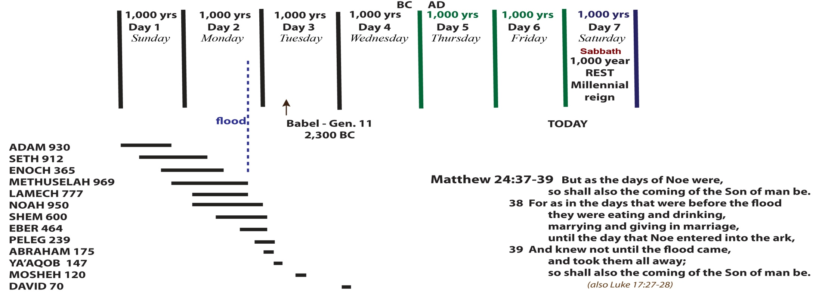
Creation is a Sign or Pattern of Prophecy 2 Peter 3:6-10 Whereby the world that then was, being overflowed with water, perished: 7 But the heavens and the earth, which are now, by the same word are kept in store, reserved unto fire against the day of judgment and perdition of ungodly men. 8 But, beloved, be not ignorant of this one thing, that one day is with the Lord as a thousand years, and a thousand years as one day. 9 The Lord is not slack concerning his promise, as some men count slackness; but is longsuffering to us-ward, not willing that any should perish, but that all should come to repentance. 10 But the day of the Lord will come as a thief in the night; in the which the heavens shall pass away with a great noise, and the elements shall melt with fervent heat, the earth also and the works that are therein shall be burned up.

Slide 16
Selah Used in reference to the Millenium
Mentioned 70 times in Psalm and 3 times in Habakkuk 3
Psalm 67:1 God be merciful unto us, and bless us; and cause his face to shine upon us; Selah.
2 That thy way may be known upon earth, thy saving health among all nations.
3 Let the people praise thee, O God; let all the people praise thee.
4 O let the nations be glad and sing for joy: for thou shalt judge the people righteously, and govern the nations upon earth. Selah.
5 Let the people praise thee, O God; let all the people praise thee.
6 Then shall the earth yield her increase; and God, even our own God, shall bless us.
7 God shall bless us; and all the ends of the earth shall fear him.

Slide 17
Two Types of PROPHECY
Fullfilled Prophecy (past)
Predictive Prophecy (future)
Fulfilled Prophecy (past)
This strengthens your faith in God’s Word
Look at John 2:13-21
The Jew Prophecy is a pattern or a sign
To the Western mind Prophecy is predictive
1 Corinthians 1:22 For the Jews require a sign, and the Greeks seek after wisdom:

Slide 18
John 2:13-21
The Jew Prophecy is a pattern or a sign
To the Western mind Prophecy is predictive
John 2:13-21 And the Jews' passover was at hand, and Jesus went up to Jerusalem,
14 And found in the temple those that sold oxen and sheep and doves, and the changers of money sitting:
15 And when he had made a scourge of small cords, he drove them all out of the temple, and the sheep, and the oxen; and poured out the changers' money, and overthrew the tables;
16 And said unto them that sold doves, Take these things hence; make not my Father's house an house of merchandise.
17 And his disciples remembered that it was written, The zeal of thine house hath eaten me up.
18 Then answered the Jews and said unto him, What sign shewest thou unto us, seeing that thou doest these things?
19 Jesus answered and said unto them, Destroy this temple, and in three days I will raise it up.
20 Then said the Jews, Forty and six years was this temple in building, and wilt thou rear it up in three days?
21 But he spake of the temple of his body.
Matthew 12:38-40 Then certain of the scribes and of the Pharisees answered, saying, Master, we would see a sign from thee. We think they were asking for an on-the-spot-miracle but they weren’t
39 But he answered and said unto them, An evil and adulterous generation seeketh after a sign; and there shall no sign be given to it, but the sign of the prophet Jonas:
40 For as Jonas was three days and three nights in the whale's belly; so shall the Son of man be three days and three nights in the heart of the earth.

Slide 19
Signs or Patterns of Prophecy in the O.T.
The Feasts of Jehovah – Leviticus 23
The Tabernacle 46 chapters of typology
Nebuchadnezzar’s Dream – Daniel 2
Daniel’s 70 weeks – Daniel 9

Slide 20
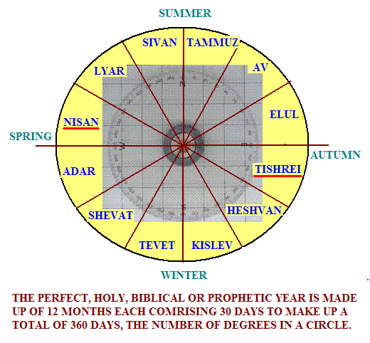
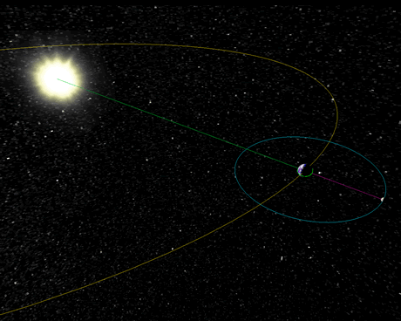
Introduction to the Jewish or Biblical Prophetic Calendar
We use a lunar year
The Jewish calendar was 12 months of 30 days
365.24199 days

Slide 21
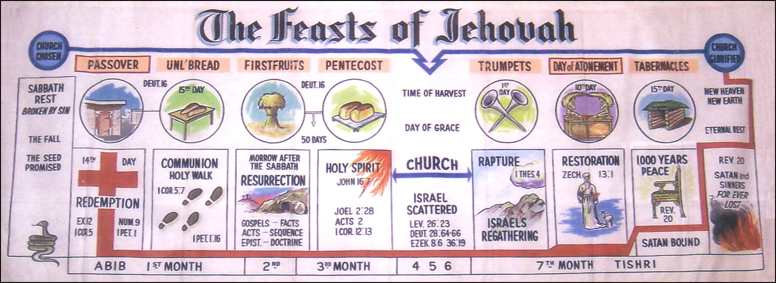
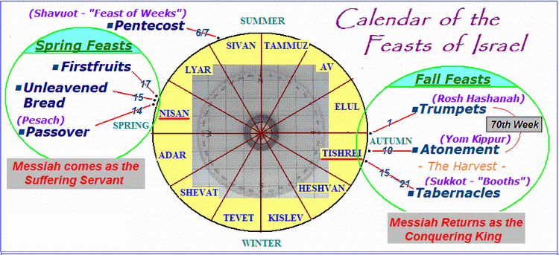
The Feasts of Jehovah Leviticus 23

Slide 22
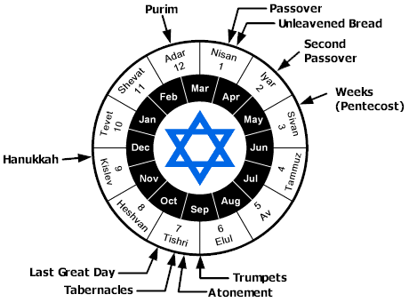
The Feasts of Jehovah Leviticus 23
The first 4 have been fulfilled exactly by Jesus Christ
Firstfruits

Slide 23
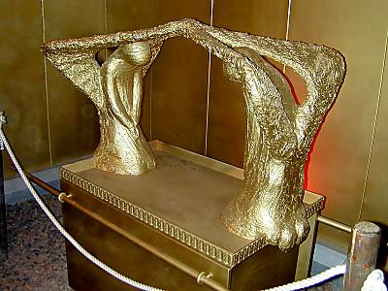
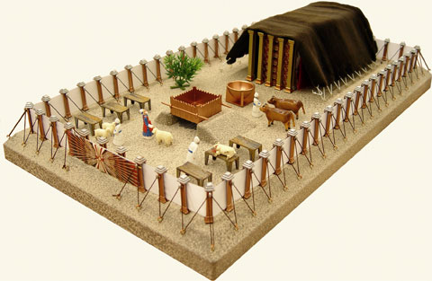
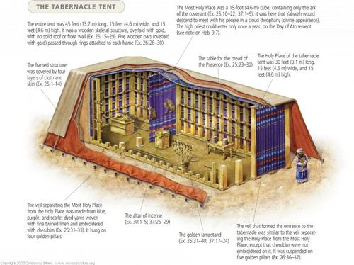
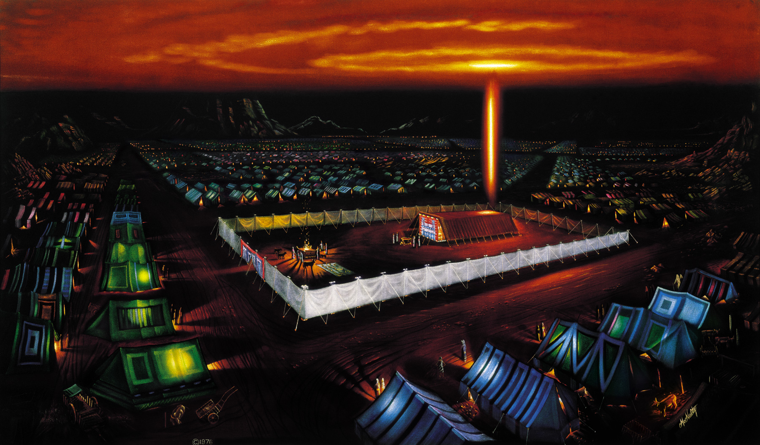
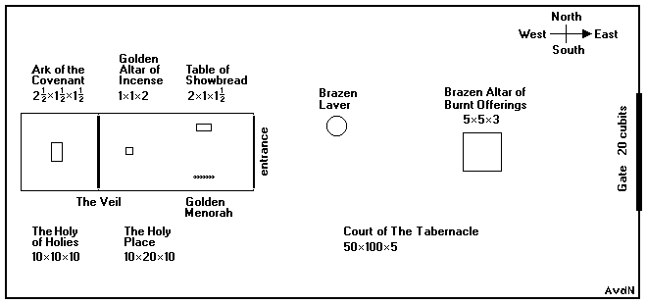
The Tabernacle

Slide 24
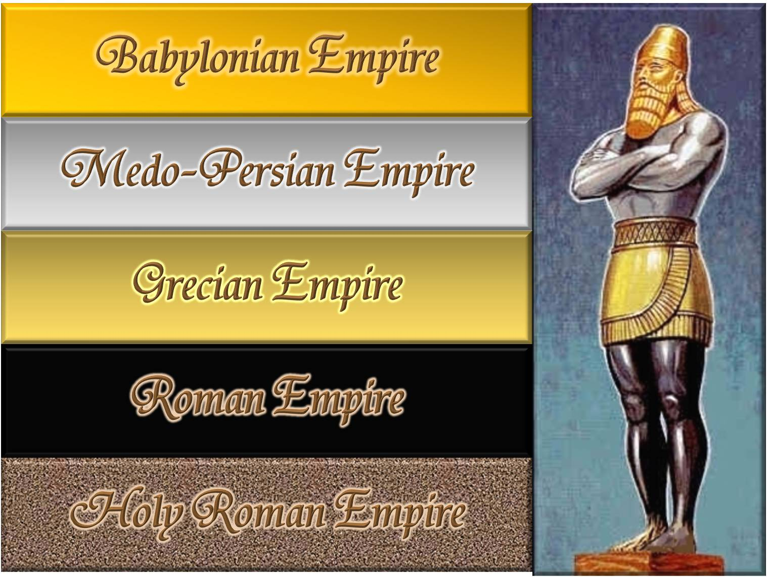
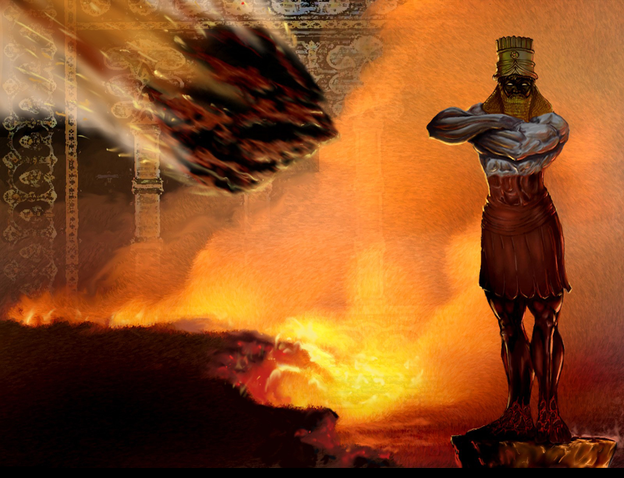
Nebuchadnezzar’s Dream Daniel 2
Greatest chapter of prophecy in the Word of God.
From Babylon to the end of the Millennium is 3,500 years.
This is why modernists and liberals hate the book of Daniel more than any other book.
536-331 B.C.
331-27 B.C.
606-536 B.C.
Revelation 11:15 …The kingdoms of this world are become the kingdoms of our Lord, and of his Christ; and he shall reign for ever and ever.
Daniel 2:34 … a stone was cut out without hands, which smote the image upon his feet that were of iron and clay, and brake them to pieces.
Daniel 2:45 Forasmuch as thou sawest that the stone was cut out of the mountain without hands, and that it brake in pieces the iron, the brass, the clay, the silver, and the gold; …

Slide 25
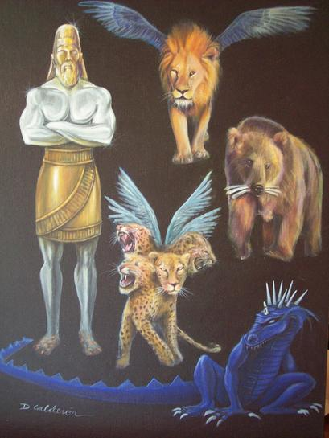
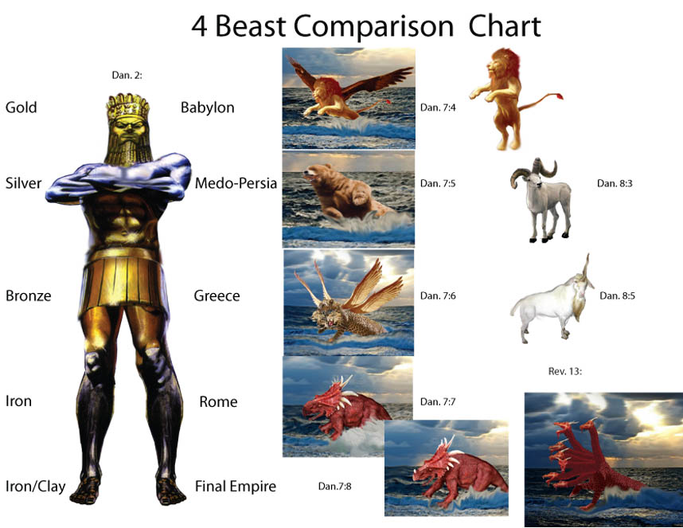
Nebuchadnezzar’s Dream Daniel 2 Man’s impression of himself Daniel 7 (Daniel’s Vision) How God Sees Us

Slide 26
Daniel’s 70 weeks in Daniel 9
Daniel knew the prophecy that Jeremiah had told of the Babylonian captivity
Jeremiah 25:9-12 Behold, I will send … Nebuchadrezzar the king of Babylon, my servant, and will bring them against this land, and against the inhabitants thereof, and against all these nations round about, and will utterly destroy them, and make them an astonishment, and an hissing, and perpetual desolations.
11 And this whole land shall be a desolation, and an astonishment; and these nations shall serve the king of Babylon seventy years.
And it shall come to pass, when seventy years are accomplished, that I will punish the king of Babylon, …
God would fully restore Israel not after the 70 years captivity, but after the 70 week period in Daniel 9:24-27
God’s program would be finished in seventy heptads, or seventy ‘sevens’ of years.
Our KJV calls heptads “weeks”.
History interprets this as 70 x 7 prophetic years = 490 years.
Today, people think in terms of tens (decades).
Daniel’s people thought in terms of sevens (heptads).
Every seventh year was a sabbath rest year (Leviticus 25:1-7).
Seven ‘sevens’ = 7 x 7 = 49 years brought Israel to the year of Jubilee (Leviticus 25:8-12).
70 x 7 years is a span of 490 years.

Slide 27
Daniel’s 70 Weeks
540 years before it took place, God predicted the exact day that Messiah would ride into Jerusalem and present Himself Prince of Israel.
4 declarations concerning Jerusalem
Artaxerxes Longimanus’ decree to Ezra in 457 BC
This decree concerns finances for animal sacrifices at the temple
Gentile Church
period or gap
Artaxerxes Longimanus’ decree to Nehemiah in March 5, 444 BC
in Nehemiah 2:1-8 to rebuild the wall.
Darius I decree in 512 BC
Darius searched out
Cyrus’ decree, and then issued a decree himself in 512 BC confirming Cyrus’ original decree
Cyrus’ decree October 29, 539 BC
to rebuild the temple,
not the city.
Midst of the week
Unto the Messiah
the Prince
3 ½ yrs
42 months
1260 days
Daniel 11
Vision of the “Silent Years”
330-167 BC
7 years
539
457
March 5, 444
69 weeks
69 x 7 = 483 years
or
173,880 days
March 30, 33 AD
70th Week
512
The Anti-Christ makes a covenant to protect Israel after the Rapture

Slide 28
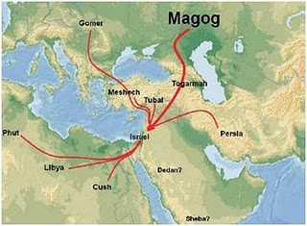
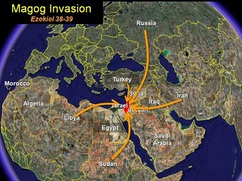
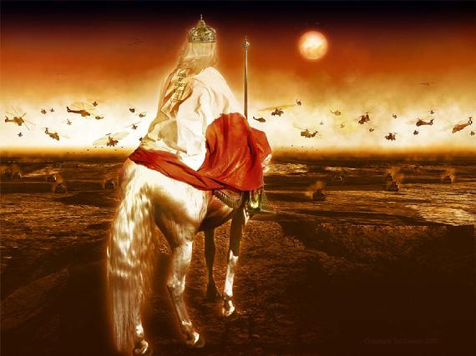
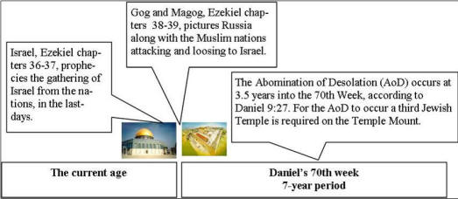
The Coming Russian and Muslim Invasion of Israel
EZEKIEL 38-39
Armagedon happens at the end of the 7 year Tribulation

